Slide 1
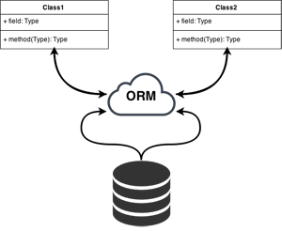
Object Relational Mapping
Wladymir Brborich

Slide 2
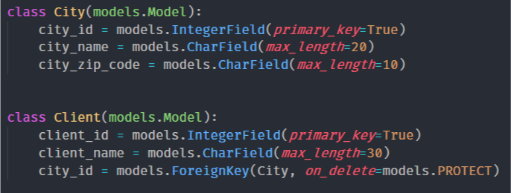
Why ORM?
It allows us to interpret a relational database, as a set of objects, and use its properties and methods.
Makes the interaction with the database easier
You worry only about the data, not the queries

Slide 3
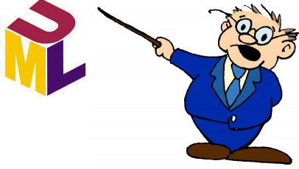
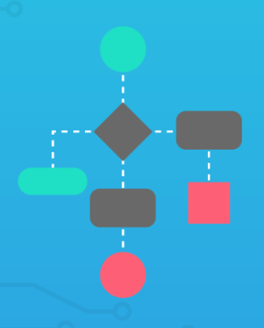
Django Models
As in the example before, these are the representations of our relational database.
When you create a model class, you are effectively creating the template for a database table.
It eases the work of creating both an object oriented model, and a conceptual database model
More about Django Models https://docs.djangoproject.com/en/2.1/topics/db/models/

Slide 4


Working with legacy databases
You can use Django to produce models from an existing database, this allows for easy database switching.
You can learn more here: https://django-book.readthedocs.io/en/latest/chapter18.html
python manage.py inspectdb

Slide 5
Django migrations
Migrations allow you to change the database without generating it again.
They reflect your models into the database, and update such database if you change the models
They are like a versioning system.
Python manage.py makemigrations
Python manage.py migrate

Slide 6
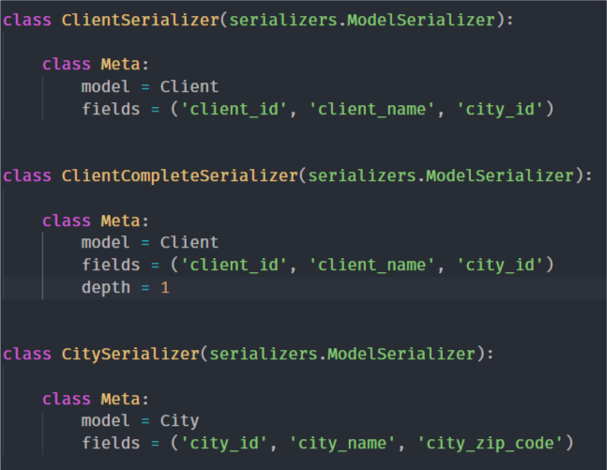
Serializers
They allow us to parse objects to json, making it easier to work with the database.
More about serializers: https://www.django-rest-framework.org/api-guide/serializers/

